Slide 1
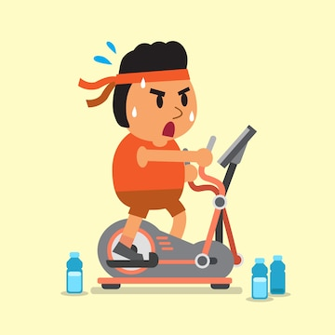
EXERCISE AND DIABETES
Dr.Manish Shukla
Dept. of Cardiovascular & Respiratory Physiotherapy
MGM Institute Of Physiotherapy
Chh. Sambhajinagar

Slide 2
Contents
Introduction - Diabetes
Pathophysiology
Effects On Different System
Exercising In Diabetes
Summary

Slide 3
INTRODUCTION
Type 2 Diabetes Mellitus (T2DM) is one of the most common metabolic disorders worldwide.
Diabetes Estimate of 79,194 in 1,O00,05 (International Diabetes Federation 2021)
DIABETES MELLITUS
Autoimmune Frequent Genetic Background
Genetic Susceptibility (HLA DR 3, 4) Obesity, poor nutrition, physical inactivity
Islets cell Antibody Defective insulin secretion by pancreatic β-cells
Type 1
Type 2

Slide 4
Type 2 DM is primarily caused by a combination of two main factors:
1.Defective insulin secretion by pancreatic β-cells
2. Inability of insulin-sensitive tissues to respond to insulin.
Insulin sensitivity refers to how sensitive the body’s cells are in response to insulin.
A person with low insulin sensitivity also has insulin resistance.

Slide 5
BETA CELL DYSFUNCTION
Beta cell insults include cytokine-induced inflammation, obesity and insulin resistance, and overconsumption of saturated fat and free fatty acids (FFA).
A progressive decline of beta cell function leading to beta cell exhaustion precedes beta cell demise.
An excess of FFAs and hyperglycaemia lead to β-cell dysfunction by inducing ER stress.
Lipotoxicity, glucotoxicity and glucolipotoxicity occurring in obesity, induce metabolic and oxidative stress that leads to β-cell damage.

Slide 6
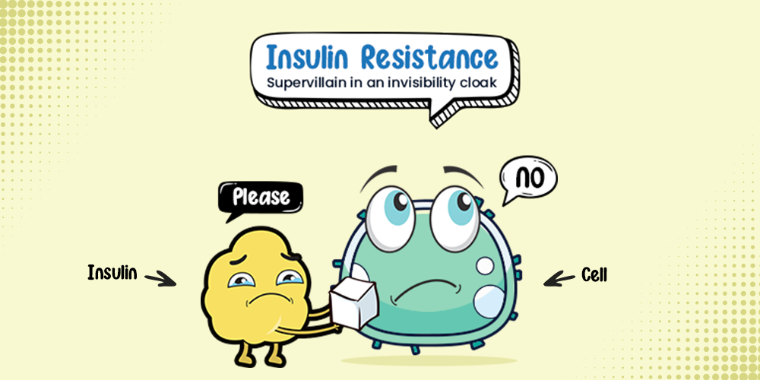
INSULIN RESISTANCE

Slide 7
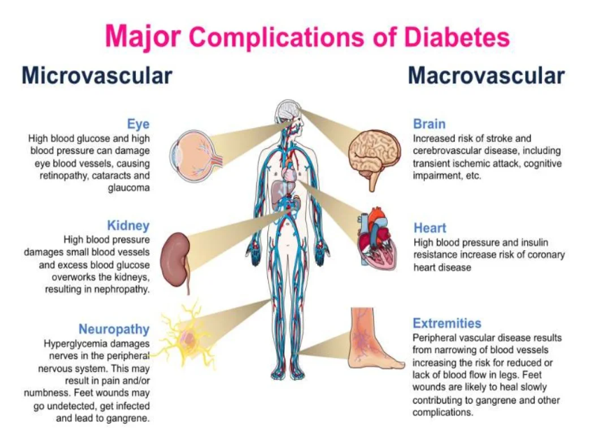
EFFECTS OF DIABETES MELLITUS ON BODY SYSTEMS

Slide 8
EFFECTS OF DIABETES MELLITUS ON BODY SYSTEMS
CARDIOVASCULAR SYSTEM:
Adipose tissue dysfunction
Adipokines are related to IR, and can result in endothelial dysfunction, and pro-inflammatory and pro-atherogenic states.
Adiponectin is a well-described insulin-sensitizing hormone .
Adiponectin deficiency is associated with coronary artery disease, hypertension, endothelial dysfunction and greater carotid intima-media thickness

Slide 9
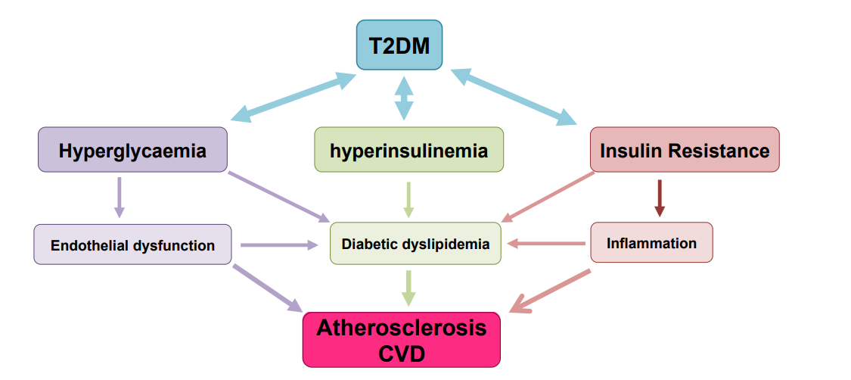
EFFECTS OF DIABETES MELLITUS ON BODY SYSTEMS
CARDIOVASCULAR SYSTEM:

Slide 10
EFFECTS OF DIABETES MELLITUS ON BODY SYSTEMS
NERVOUS SYSTEM:
The literature reports from 50% to 66% of patients with DM will eventually develop PN at some point during their lifetime.
Peripheral neuropathy is a type of nerve damage that typically affects the feet and legs and sometimes affects the hands and arms.
Autonomic neuropathy is damage to nerves that control your internal organs, leading to problems with your heart rate and blood pressure, digestive system, bladder, sex organs, sweat glands, and eyes.

Slide 11
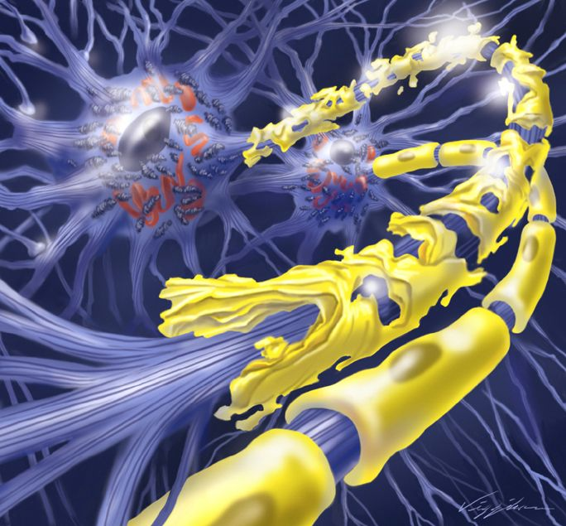
EFFECTS OF DIABETES MELLITUS ON BODY SYSTEMS
NERVOUS SYSTEM:
Focal neuropathies are conditions in which
you typically have damage to single nerves,
most often in your hand, head, torso, or leg.
Proximal neuropathy is a rare and disabling
type of nerve damage in your hip, buttock,
or thigh.

Slide 12
EFFECTS OF DIABETES MELLITUS ON BODY SYSTEMS
NERVOUS SYSTEM:
Implicated causes of peripheral nerve damage include
Oxidate stress damage
Accumulation of sorbitol - Excess sorbitol may produce toxic effects, resulting in demyelination and impaired velocity of peripheral nerve conduction.
Advanced glycosylation end products
Neurovascular impairment with poor repair processes and endothelial dysfunction also have been implicated.

Slide 13
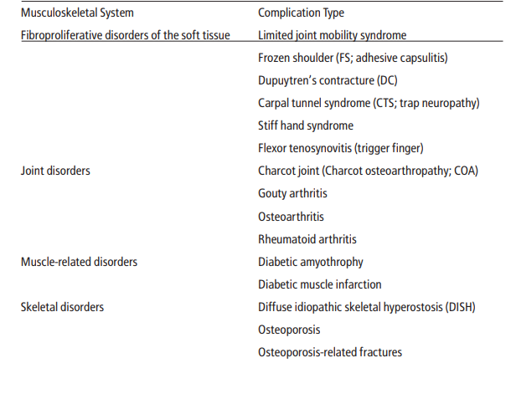
EFFECTS OF DIABETES MELLITUS ON BODY SYSTEMS
MUSCULOSKELETAL SYSTEM:

Slide 14
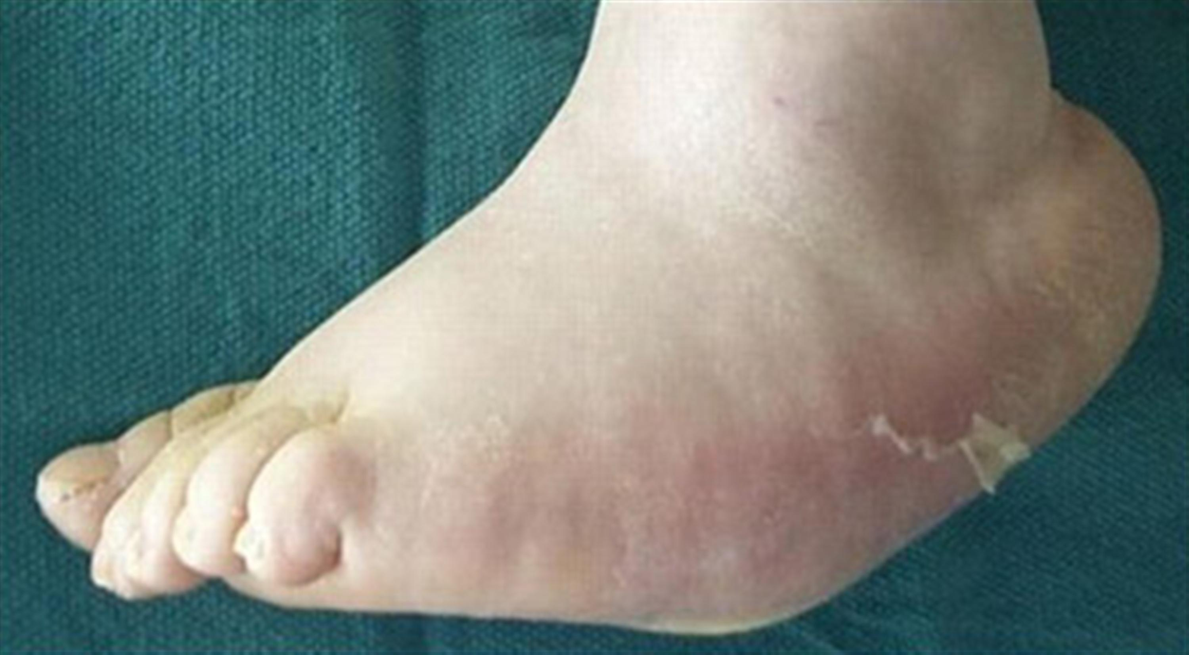
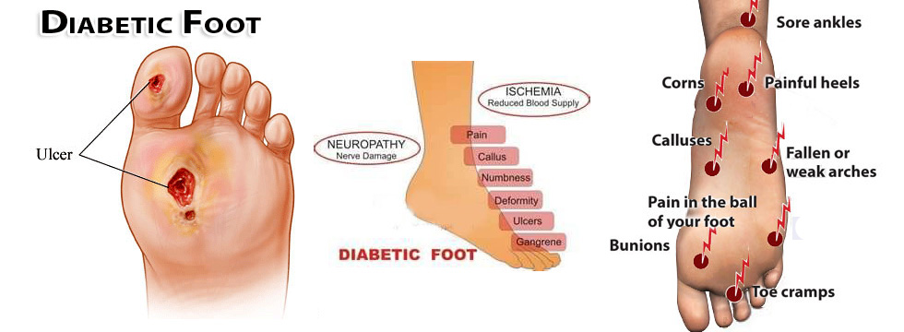

Slide 15
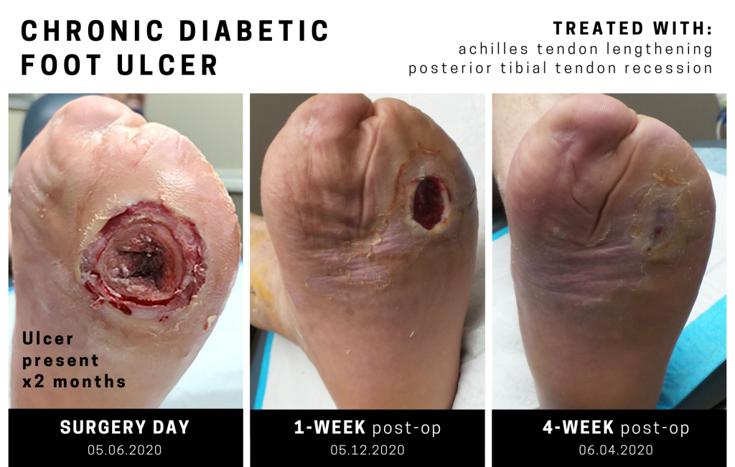


Slide 16
EFFECTS OF DIABETES MELLITUS ON BODY SYSTEMS
MUSCULOSKELETAL SYSTEM:
GLUT4 is an insulin-regulated glucose transporter that is responsible for insulin-regulated glucose uptake into fat and muscle cells.
GLUT4 trafficking might represent one of the earliest defects contributing to insulin resistance in humans .
Upon insulin binding to insulin receptor (INSR) in muscle cells, GLUT4 translocate from intracellular compartments to the plasma membrane. This process allows glucose uptake and reduces circulating glucose levels

Slide 17
EFFECTS OF DIABETES MELLITUS ON BODY SYSTEMS
MUSCULOSKELETAL SYSTEM:
Mutations that reduce the expression of insulin receptor or GLUT4, as well as any defect in either upstream or downstream signaling pathway would reduce glucose intake into the muscle resulting in a hyperglycemic state .

Slide 18
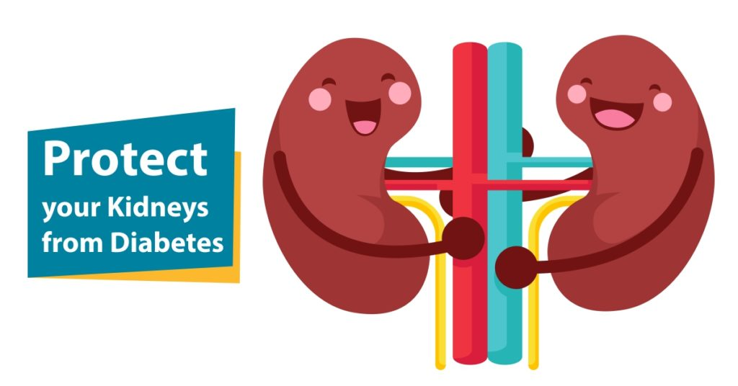
EFFECTS OF DIABETES MELLITUS ON BODY SYSTEMS
RENAL SYSTEM:
Over time, poorly controlled diabetes can cause damage to blood vessel clusters in your kidneys that filter waste from your blood.
This can lead to kidney damage and cause high blood pressure.
High blood pressure can cause further kidney damage by increasing the pressure in the delicate filtering system of the kidneys.

Slide 19
EFFECTS OF DIABETES MELLITUS ON BODY SYSTEMS
TELOMERE LENGTH:
Telomeres are specialised DNA-protein structures at the end of all chromosomes, which preserve chromosome stability and integrity.
Exposure to free radicals or oxidants causes DNA damage including single-strand breaks and telomere erosion as shown with in vitro experiments.
Prediabetes and metabolic syndrome are associated with increased oxidative stress.
So, consequent shortened telomeres, which eventually lead to premature senescence.

Slide 20
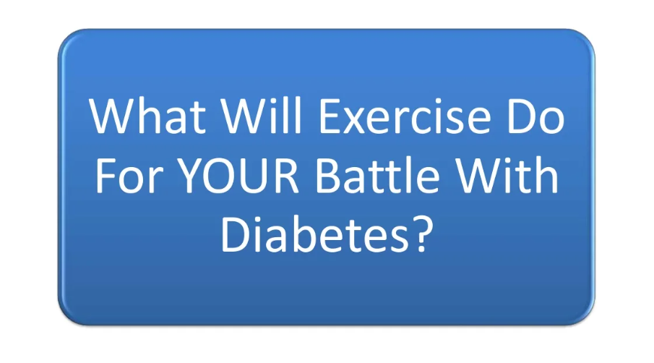
EFFECTS OF EXERCISE ON DIABETES MELLITUS

Slide 21
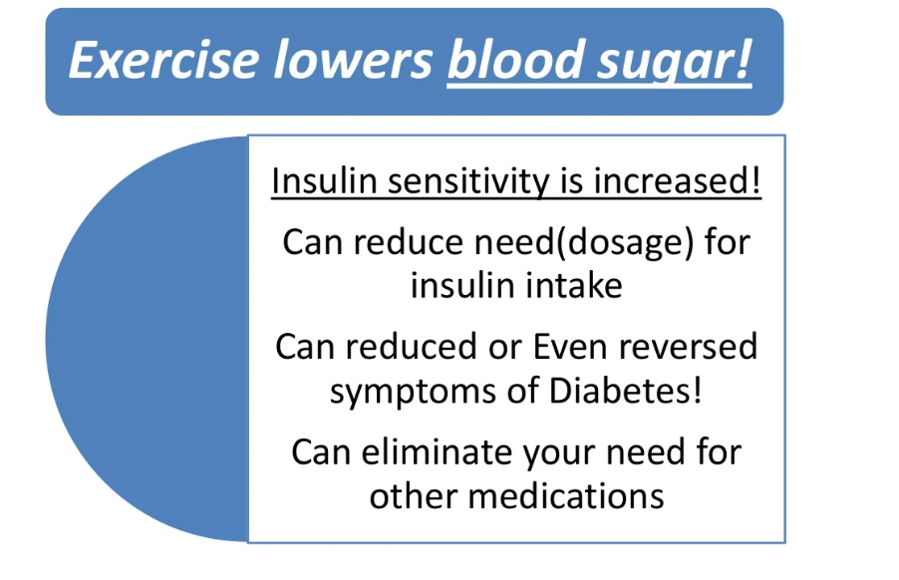
EFFECTS OF EXERCISE ON DIABETES MELLITUS

Slide 22
Effects of Acute Exercise on Skeletal Muscle Glucose Uptake
Effects of Acute Exercise on Skeletal Muscle Glucose Uptake :
Both insulin and exercise increase skeletal muscle glucose uptake by translocation of glucose transporter 4 (GLUT4), the predominant GLUT in muscle, from an intracellular location to the plasma membrane.
Insulin and exercise stimulate GLUT4 translocation through distinct signalling mechanisms.

Slide 23
Effects of Acute Exercise on Skeletal Muscle Glucose Uptake
Exercise improves insulin sensitivity and may contribute to the prevention of type 2 diabetes (Pedersen & Saltin, 2015).
Insulin-stimulated glucose uptake is initiated by insulin binding to and activating the insulin receptor (IR) on the muscle plasma membrane.
This initiates a signaling cascade leading to translocation of type 4 glucose transporter (GLUT4) to the muscle plasma membrane, thereby increasing the potential for glucose uptake into skeletal muscle

Slide 24
Effects of Acute Exercise on Skeletal Muscle Glucose Uptake
Pyruvate dehydrogenase (PDH) is responsible for the first step in the conversion of pyruvate to acetyl-CoA in mitochondria, thereby acting as a central regulator of glucose oxidation.
It has been proposed that impaired PDH function plays a causative role in the development of skeletal muscle insulin resistance and that exercise can remedy this impairment.

Slide 25
Effects of Exercise on Skeletal Muscle Glucose Uptake
Effect of exercise training on skeletal muscle protein expression in relation to insulin sensitivity: Per-protocol analysis of a randomized controlled trial (GO-ACTIWE)
- 2021
- Lea Bruhn1,2 | Rasmus Kjøbsted
- Pyruvate Dehydrogeanse.
Previous studies have shown an increase in GLUT4 expression after 3–10 weeks of endurance exercise training in both healthy young men, with and without overweight

Slide 26
Effects of Acute Exercise on Skeletal Muscle Glucose Uptake
Effects of Chronic Exercise on Skeletal Muscle Glucose Uptake :
It is well established that endurance exercise training increases skeletal muscle GLUT4 . The increase in skeletal muscle GLUT4 causes an increase in skeletal muscle glucose uptake
The recommended amount of exercise for people with type 2 diabetes is 150 min of moderate intensity exercise per week

Slide 27
Effects of Acute Exercise on Skeletal Muscle Glucose Uptake
There are studies indicating that HIT is a potential time-efficient exercise strategy for the treatment of type 2 diabetes.

Slide 28
Effects of Chronic Exercise on Skeletal Muscle Mitochondria
People with type 2 diabetes have been reported to have smaller, damaged, or dysfunctional mitochondria .
Endurance exercise training has been shown to increase mitochondrial content and activity.
Exercise and type 2 diabetes: molecular mechanisms regulating glucose uptake in skeletal muscle
Kristin I. Stanford

Slide 29
MODALITIES OF EXERCISES
Aerobic Exercise
Resistance Exercise
Flexibilty and balance exercise

Slide 30
Aerobic Exercise Benefits
Aerobic training increases mitochondrial density, insulin sensitivity, oxidative enzymes, compliance and reactivity of blood vessels, lung function, immune function, and cardiac output.
Moderate to high volumes of aerobic activity are associated with substantially lower cardiovascular and overall mortality risks in both type 1 and type 2 diabetes .

Slide 31
TYPE 1 DIABETES | TYPE 2 DIABETES
Aerobic training increases cardiorespiratory fitness, decreases insulin resistance, and improves lipid levels and endothelial function. | Regular training reduces A1C, triglycerides, blood pressure, and insulin resistance
Can be performed without deterioration in glycemic control in type 1 diabetes | High-intensity interval training (HIIT) promotes rapid enhancement of skeletal muscle oxidative capacity, insulin sensitivity, and glycemic control in adults with type 2 diabetes

Slide 32
Resistance Exercise Benefits
Diabetes is an independent risk factor for low muscular strength and accelerated decline in muscle strength and functional status.
The health benefits of resistance training for all adults include improvements in muscle mass, body composition, strength, physical function, mental health, bone mineral density, insulin sensitivity, blood pressure, lipid profiles, and cardiovascular health.

Slide 33
TYPE 1 DIABETES | TYPE 2 DIABETES
The effect of resistance exercise on glycemic control in type 1 diabetes is unclear. | Improvements in glycemic control, insulin resistance, fat mass, blood pressure, strength, and lean body mass (
Resistance exercise can assist in minimizing risk of exercise-induced hypoglycemia in type 1 diabetes
KEY NOTE :
When resistance and aerobic exercise are undertaken in one exercise session, performing resistance exercise first results in less hypoglycemia than when aerobic exercise is performed first

Slide 34
Flexibility Exercise Benefits
Flexibility and balance exercises are likely important for older adults with diabetes.
Limited joint mobility is frequently present, resulting in part from the formation of advanced glycation end products, which accumulate during normal aging and are accelerated by hyperglycemia.
Balance training can reduce falls risk by improving balance and gait, even when peripheral neuropathy is present
BUT NO GLYCAEMIC CONTROL!!

Slide 35
Flexibility Exercise Benefits
The benefits of alternative training like yoga and tai chi are less established, although yoga may promote improvement in glycemic control, lipid levels, and body composition in adults with type 2 diabetes.
Tai chi training may improve glycemic control, balance, neuropathic symptoms, and some dimensions of quality of life in adults with diabetes and neuropathy, although high-quality studies on this training are lacking.
JOINT STATEMENT BY ADA

Slide 36
OBESITY MANAGEMENT
Helps in regulating the sensitivity by lowering the resistance and increased uptake.
Now Lets together learn how different complications can be controlled well by exercises !????

Slide 37
AEROBIC
RESISTANCE
DIET KEY OF ALL
PHYSICAL ACTIVTY
REGULAR EXERCISE

Slide 38
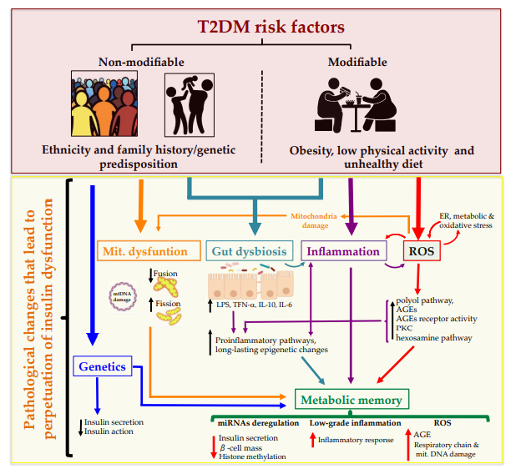
SUMMARY

Slide 39
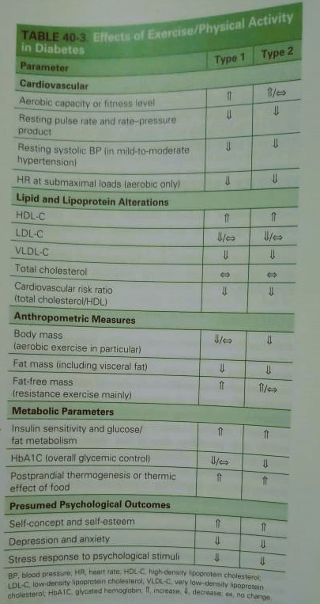

Slide 40
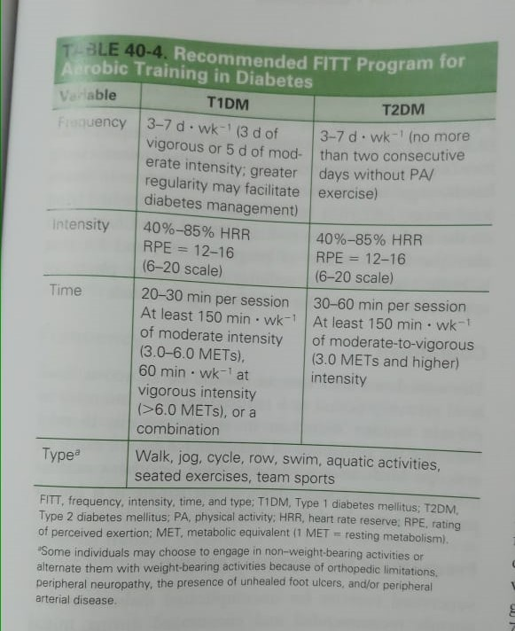

Slide 41
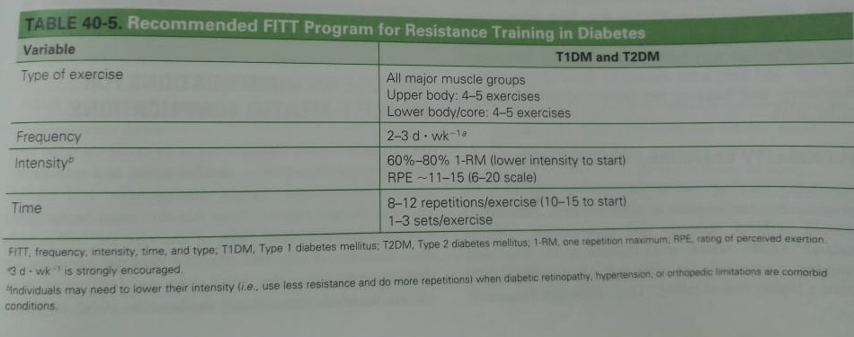

Slide 42
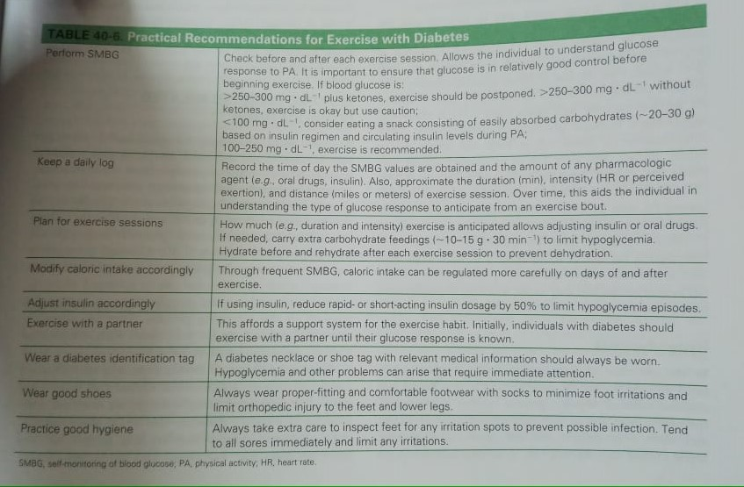

Slide 43
DOUBTS OR QUESTIONS!???

Slide 44
REFERENCE
Galicia-Garcia U, Benito-Vicente A, Jebari S, Larrea-Sebal A, Siddiqi H, Uribe KB, Ostolaza H, Martín C. Pathophysiology of type 2 diabetes mellitus. International journal of molecular sciences. 2020 Aug 30;21(17):6275.
Cerf ME. Beta cell dysfunction and insulin resistance. Frontiers in endocrinology. 2013 Mar 27;4:37.
Bruhn L, Kjøbsted R, Quist JS, Gram AS, Rosenkilde M, Færch K, Wojtaszewski JF, Stallknecht B, Blond MB. Effect of exercise training on skeletal muscle protein expression in relation to insulin sensitivity: Per‐protocol analysis of a randomized controlled trial (GO‐ACTIWE). Physiological reports. 2021 May;9(10):e14850.
Wahl MP, Scalzo RL, Regensteiner JG, Reusch JE. Mechanisms of aerobic exercise impairment in diabetes: a narrative review. Frontiers in Endocrinology. 2018 Apr 18;9:181.
Colberg SR, Sigal RJ, Fernhall B, Regensteiner JG, Blissmer BJ, Rubin RR, Chasan-Taber L, Albright AL, Braun B. Exercise and type 2 diabetes: the American College of Sports Medicine and the American Diabetes Association: joint position statement executive summary. Diabetes care. 2010 Dec 1;33(12):2692-6.
Richter EA. Is GLUT4 translocation the answer to exercise-stimulated muscle glucose uptake?. American Journal of Physiology-Endocrinology and Metabolism. 2021 Jan 1;320(2):E240-3.

Slide 45
REFERENCE
7. Zhang H, Zhang C. Adipose “talks” to distant organs to regulate insulin sensitivity and vascular function. Obesity (Silver Spring, Md.). 2010 Nov;18(11):2071.
8. Wang J, Dong X, Cao L, Sun Y, Qiu Y, Zhang Y, Cao R, Covasa M, Zhong L. Association between telomere length and diabetes mellitus: a meta-analysis. Journal of International Medical Research. 2016 Dec;44(6):1156-73.
9. Seyedizadeh SH, Cheragh-Birjandi S, Hamedi Nia MR. The effects of combined exercise training (resistance-aerobic) on serum kinesin and physical function in type 2 diabetes patients with diabetic peripheral neuropathy (randomized controlled trials). Journal of diabetes research. 2020 Mar 9;2020.
10. Colberg SR, Sigal RJ, Yardley JE, Riddell MC, Dunstan DW, Dempsey PC, Horton ES, Castorino K, Tate DF. Physical activity/exercise and diabetes: a position statement of the American Diabetes Association. Diabetes care. 2016 Nov 1;39(11):2065-79.
11. Yagihashi S, Mizukami H, Sugimoto K. Mechanism of diabetic neuropathy: where are we now and where to go?. Journal of diabetes investigation. 2011 Feb;2(1):18-32.

Slide 46
REFERENCE
11. Swain DP, Brawner CA, American College of Sports Medicine. ACSM's resource manual for guidelines for exercise testing and prescription. Wolters Kluwer Health/Lippincott Williams & Wilkins; 2014.

Slide 47

HAVE A NICE DAY

